Slide 1

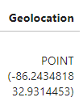
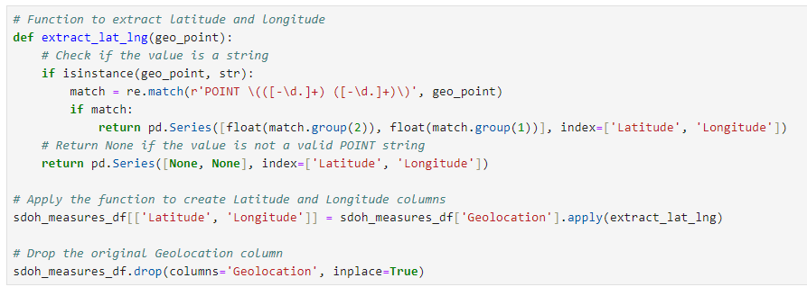

Data Cleaning and Database Prep
SDOH Measures for County, ACS 2017-2021
data.cdc.gov

Slide 2
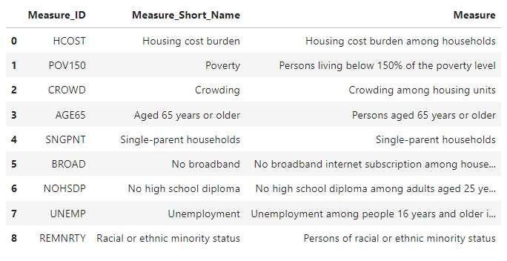
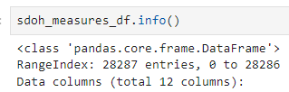

Data Cleaning and Database Prep
SDOH Measures for County, ACS 2017-2021
data.cdc.gov

Slide 3
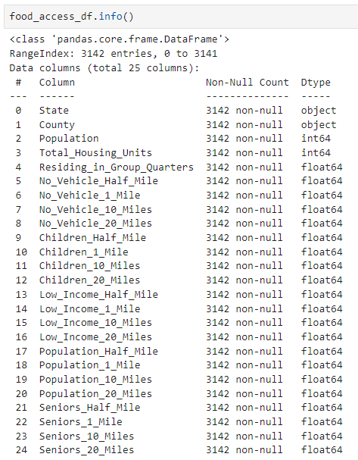
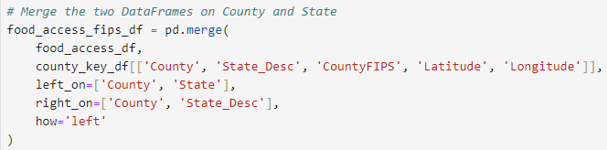
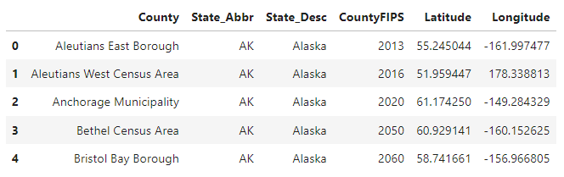
Data Cleaning and Database Prep
🍕US Food Access
www.kaggle.com/datasets

Slide 4
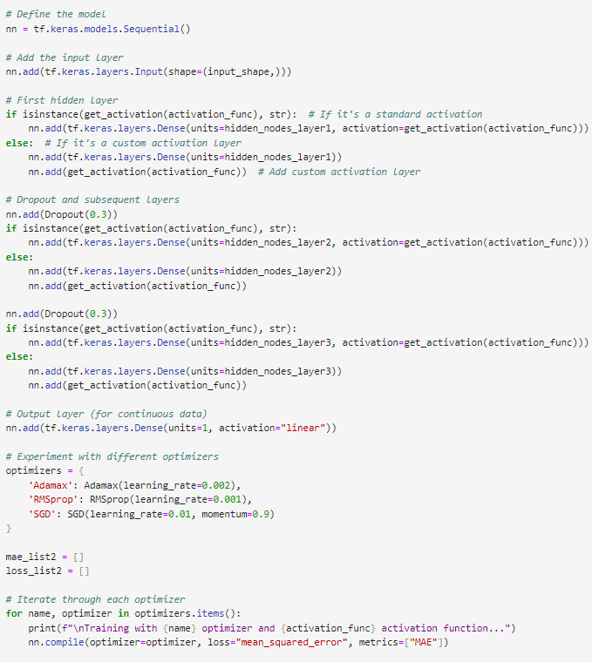

Change Function to Work with Continuous Data
Output Layer Activation
Loss Function and Metrics
Evaluate MAE
Variables to Adjust to Different Datasets
input_shape
hidden_nodes_layer1
hidden_nodes_layer2
hidden_nodes_layer3
Notes:
Circled in Red –
Output layer activation function - changed from ‘sigmoid’ to ‘linear’
Loss Function – changed from ‘binary_crossentropy’ to ‘mean_squared_error’
Appropriate loss functions could be Mean Squared Error (MSE) or Mean Absolute Error (MAE)
I chose Mean Squared Error because it is more sensitive to large errors since it squares them which encourages the model to reduce large deviations
Metrics – changed from ‘accuracy’ to ‘MAE’
Including MAE in metrics gives us an idea of the average magnitude of errors in the same units as the target variable
Since MAE was used in .complie we use it in .evaluate

Slide 5
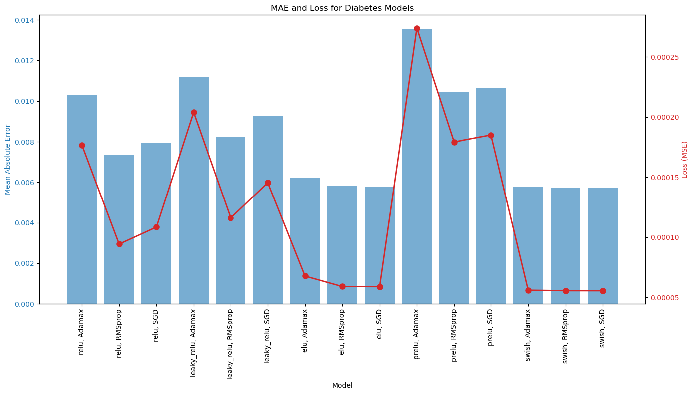
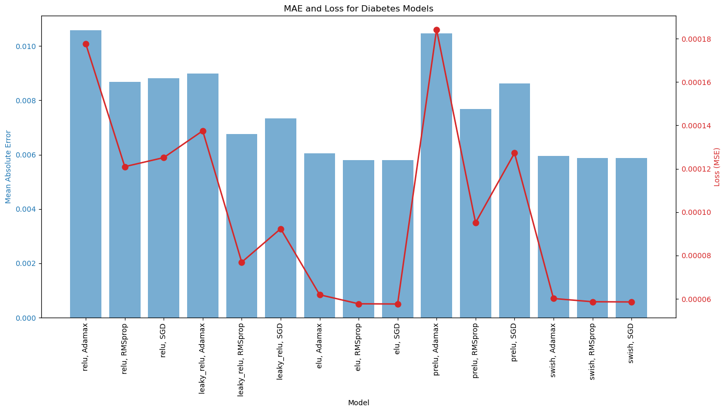
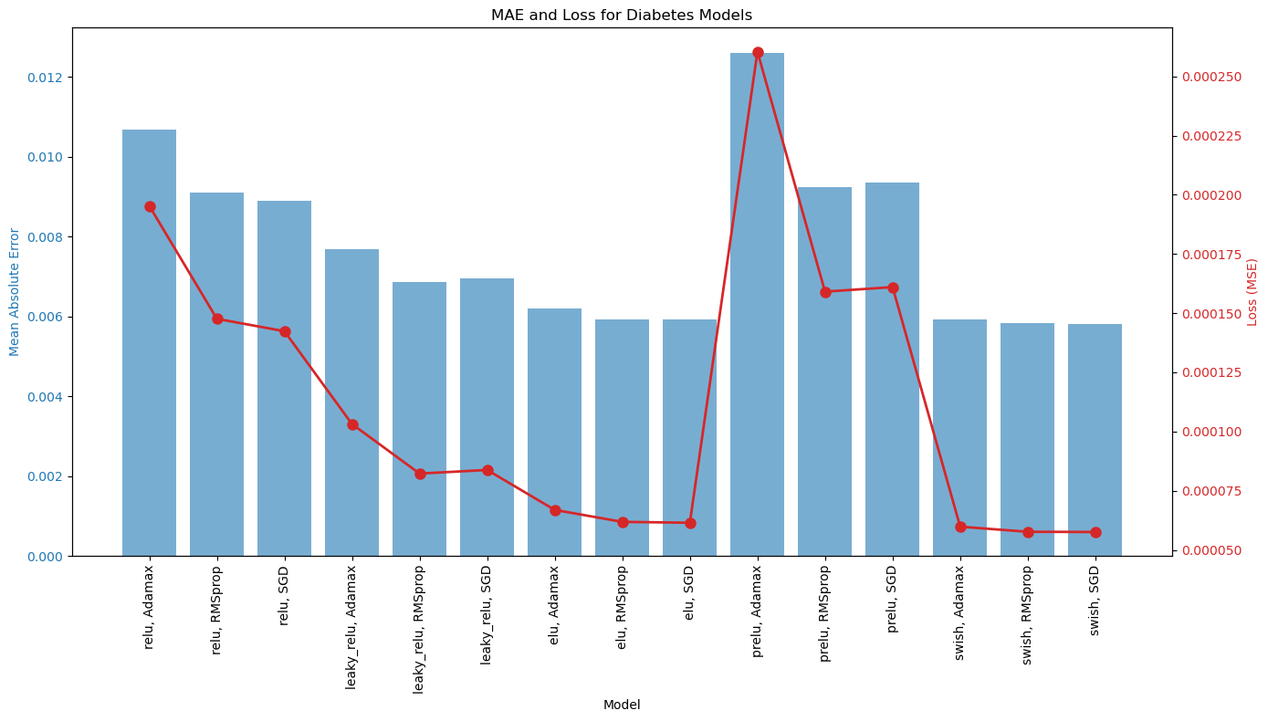
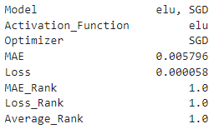
Diabetes Optimization Function
Model Optimization
Activation Function: Exponential Linear Unit (elu)
Optimizer: Stochastic Gradient Descent (SGD)
Model Performance
MAE 0.005796
Loss (MSE) 0.000058
Notes:
(ELU) is an activation function that helps the model learn complex patterns. This can lead to faster learning and improved performance.
(SGD) Is a basic optimization algorithm. While it is often slower and less efficient than more advanced optimizers like adam, it can sometimes yield better results.
MAE 0.005796 – Predictions are within 0.58% of actual value
Loss (MSE) 0.000058 – Indicates the model has learned the training data well

Slide 6
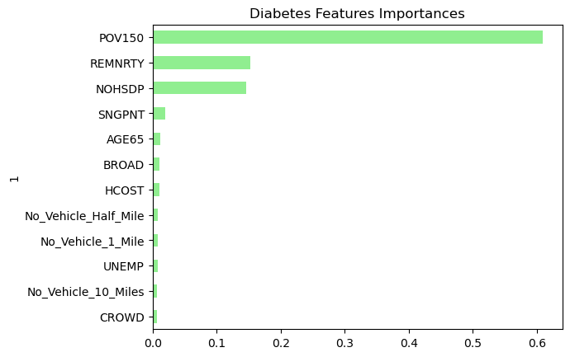

Diabetes Random Forest Regressor Evaluation Metrics
Notes:
MAE and MSE are similar values to what we found in the neural network
RMSE – Root Mean Squared Error provides an error metric in the same units as the target variable
R2 – represents the how much of the variance in the target can be explained by the model.
91.7% suggests high predictive ability
POV150 - Persons living below 150% of the poverty level
REMNRTY - Persons of racial or ethnic minority status
NOHSDP - No high school diploma among adults aged 25 years or older

Slide 7
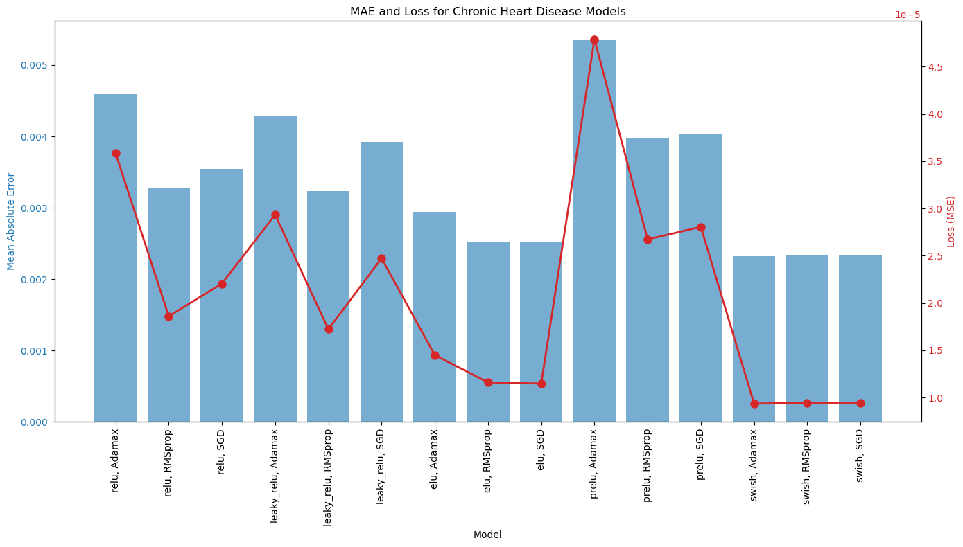
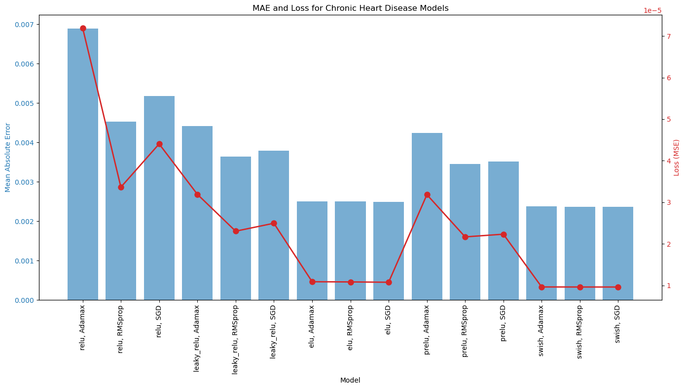
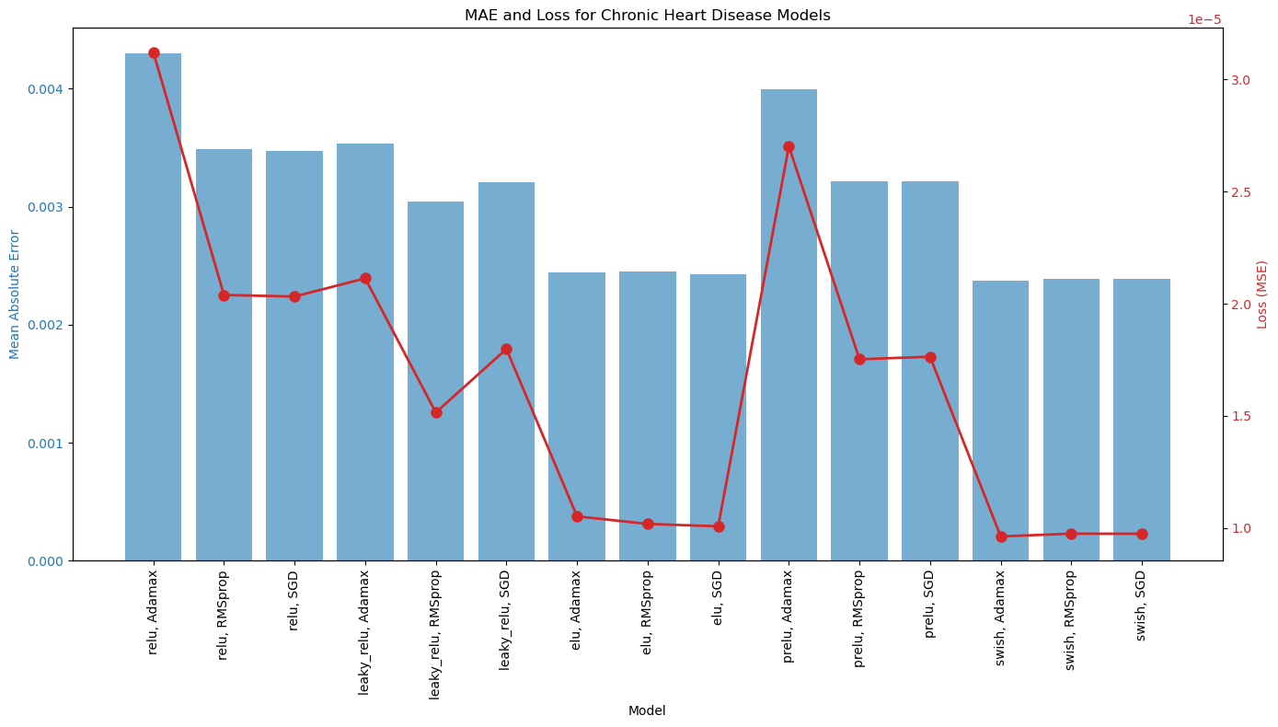
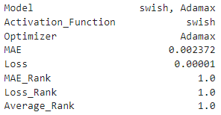
Chronic Heart Disease Optimization Function
Model Optimization
Activation Function: Swish
Optimizer: Adamax
Model Performance
MAE 0.002372
Loss (MSE) 0.00001
Notes:
Swish often outperforms traditional activation functions because it is non-monotonic, allowing more flexible learning
Adamax is a variant of the Adam optimizer. It is generally more stable and has been shown to work well for deep learning models
MAE 0.002372 – Predictions are within .24% of the actual value
Loss (MSE) 0.00001 – Indicates the model has learned the training data well

Slide 8
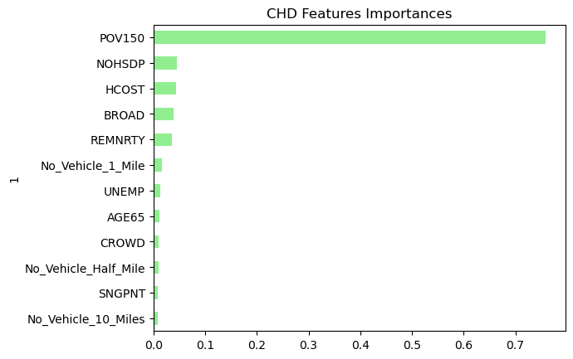

Chronic Heart Disease Random Forest Regressor Evaluation Metrics
Notes:
MAE and MSE are similar values to what we found in the neural network
RMSE – Root Mean Squared Error provides an error metric in the same units as the target variable
R2 – represents the how much of the variance in the target can be explained by the model.
88.2% suggests high predictive ability
POV150 - Persons living below 150% of the poverty level
NOHSDP - No high school diploma among adults aged 25 years or older HCOST - Housing cost burden among households
BROAD - No broadband internet subscription among households
REMNRTY - Persons of racial or ethnic minority status

Slide 9
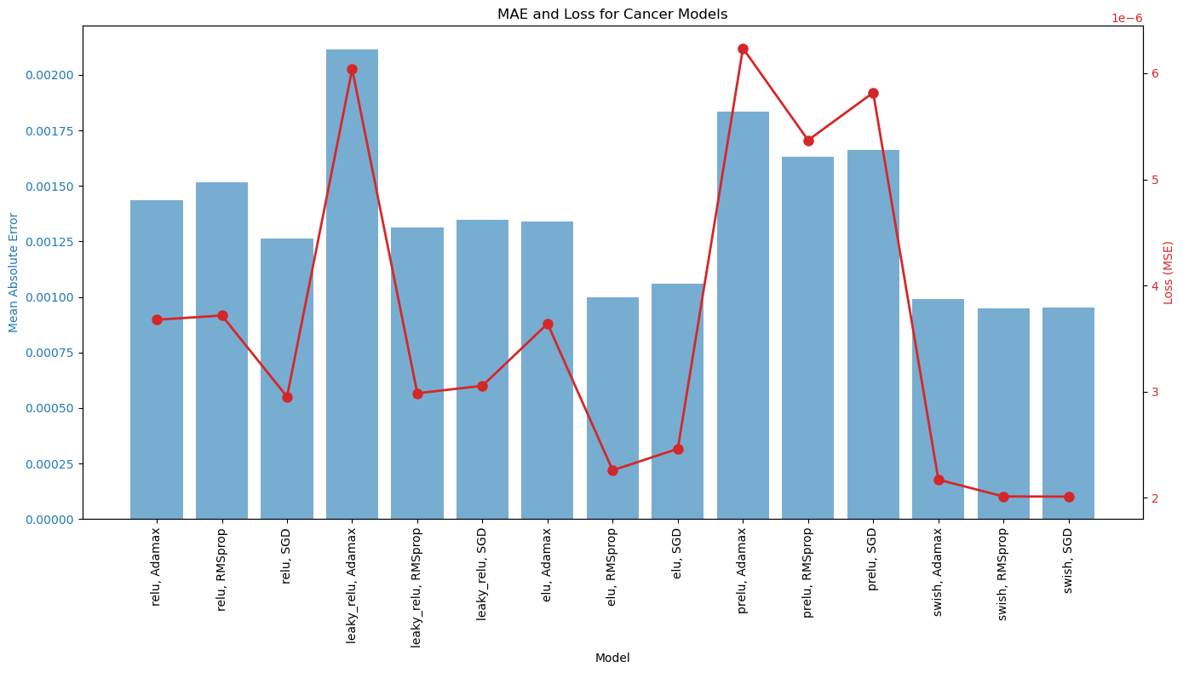
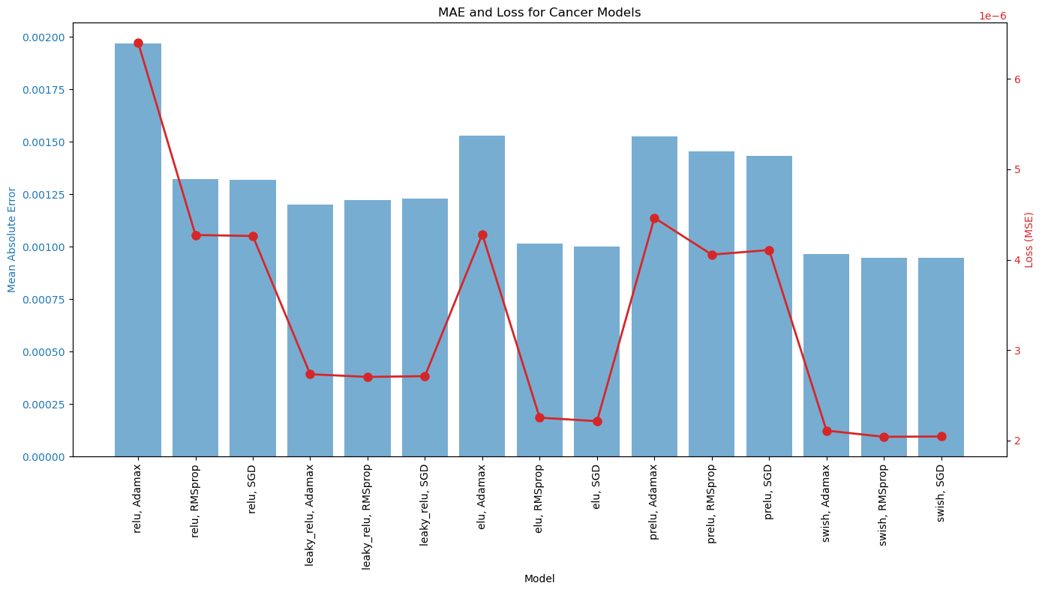
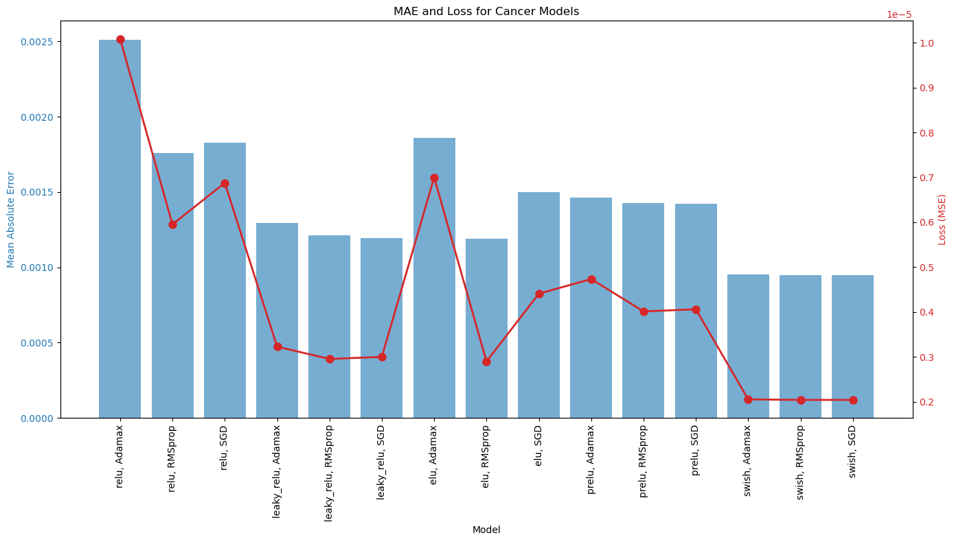
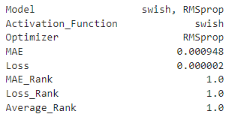
Cancer Optimization Function
Model Optimization
Activation Function: Swish
Optimizer: RMSprop
Model Performance
MAE 0.000948
Loss (MSE) 0.000002
Notes:
Swish often outperforms traditional activation functions because it is non-monotonic, allowing more flexible learning
RMSprop is an adaptive learning rate optimizer designed to handle noisy and non-stationary data
MAE 0.000948 – Predictions are within .09% of the actual value
Loss (MSE) 0.000002 – is extremely low, suggesting that the model is highly efficient at minimizing prediction errors

Slide 10
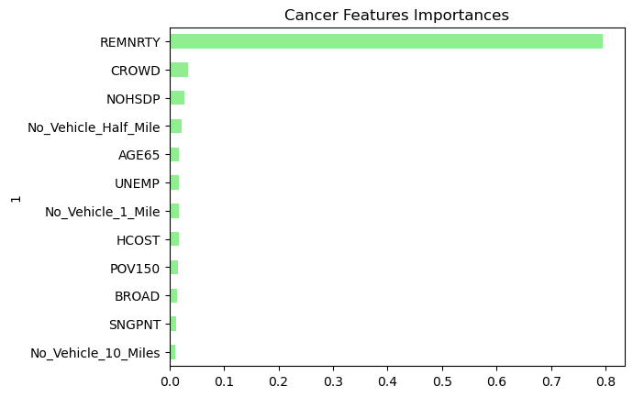

Cancer Random Forest Regressor Evaluation Metrics
Notes:
MAE and MSE are similar values to what we found in the neural network
RMSE – Root Mean Squared Error provides an error metric in the same units as the target variable
R2 – represents the how much of the variance in the target can be explained by the model.
84.8% suggests high predictive ability
REMNRTY - Persons of racial or ethnic minority status
CROWD - Crowding among housing units
NOHSDP - No high school diploma among adults aged 25 years or older

